Slide 1
Business Central AI Development
With Practical Application

Slide 2




Your Speaker
Marcel Chabot
Software Development Practice Manager
A life-long software developer and “maker”, Marcel brings experience and a unique approach to complex problems and solutions in D365

Slide 3
Session Agenda
AI Implementation Review
AI Capacity Selection
Managed vs. Unmanaged
Configure Azure Resource
Develop Business Central AL Code Use Case
Secure Store AI Credentials
Create User Interface
Interact with AI
Loop and Expand

Slide 4
Use Cases
Validations and Cleanup
Search and Recommend
Research and Suggest
An Agent to Assist

Slide 5
Goals
Working examples in your hands.
Clear walk through of the use cases and solutions.
Time for you to dig deeper into a solution that interests you.
Answer questions

Slide 6
Source Code
https://github.com/AardvarkMan/Directions-NA-2026

Slide 7
Copilot Best Practices

Slide 8
Do’s and Don’ts
Keep user informed when AI is in use.
Don’t act without permission.
Allow users to review ALL actions.

Slide 9
System Prompts
Configures the GPT system as to it’s expectations.
Define the roll as if it was a person.
Define as a storyteller for creative answers.
Define as an engineer for math.
Define output rules.
As JSON with a template.
This highly impacts the output expectations.

Slide 10
User Prompt
Represents the working data for the GPT system.
Can be embellished with additional data from the system.
Data from the sourcing record.
The user should be guided to enter good data.

Slide 11
Cost Management
Tokens = Money
4 characters ish
¾ of a word
100 tokens = 75 words
Don’t lose your API key!

Slide 12
Use Case 1: Validations and Cleanup
Accepts user entered data of unknown quality
Applies rules and validations to that data
Update the source record with good data
Notes:
Address Cleanup
Resolution Summary

Slide 13
Key Concepts
Provide minimal data to complete the task.
Detailed prompts help keep data in scope.
Dataset size corresponds with costs.
Notes:
Minimal data = minimal token

Slide 14
Code Example 1
Notes:
Customer Record
Generate Address for the Customer
Our new warehouse is at 1707 Main street. In Florida in the heart of Orlando. The postal code is 32856.
ARDCopilotAddressCleanup.CodeUnit.al
ARDAddressPrompt.Page.al
ARDCustomerCard.PageExt.al

Slide 15
Use Case 2: Search and Recommend
Analyzes data for common elements
Generates Search Criteria
BC Searches for Results
Presents Results to User for Selection

Slide 16
Key Concepts
Provide recommendation details, but not full data sets.
Use native AL code with results to complete the task.
“Sparkling Automation”
Notes:
Copilot Item Recommendations
Copilot Resolution Summary
Copilot Reminder Generator

Slide 17
Code Example 2
Notes:
Sales Order: S-OLRD101021
Sales Order - S-ORD101021 ∙ Trey Research
Clearly a Coffee Lover, coffee related items on the order.
AI doesn’t need to know the entire item list, we don’t need to index it, or process it. Standard BC Search is powerful enough, if we can use AI to extract the keywords.
ARDCopilotItemRecommendations.CodeUnit.al
ARDSalesOrder.PageExt.al – Note the word restriction keeping Tokens in check. If the list if getting longer than this, then there is limited commonality for a recommendation.

Slide 18
Use Case 3: Compare and Suggest
Reviews the user entered address data
Compares against existing addresses
Provides a recommended existing address
Notes:
Had a system that would always enter the address, but we wanted to be able to tie it to previously used address data.

Slide 19
Key Concepts
Provide the system with a list of choices
Allow the user to choose, but recommend the strongest match
Could use a lot of tokens
Notes:
Address Match Finder
BC Copilot Campaign Manager

Slide 20
Code Example 3
Notes:
Sales Quote - S-QUO1001 ∙ Trey Research
Clearly a Coffee Lover, coffee related items on the order.
AI doesn’t need to know the entire item list, we don’t need to index it, or process it. Standard BC Search is powerful enough, if we can use AI to extract the keywords.
ARDAddressMatchFinder.CodeUnit.al
ARDSalesOrder.PageExt.al

Slide 21
Use Case 4: Natural Language
Accepts parameters from User
Uses the LLM to take a “rough” statement and make it “clean”
Generate a notification
Cleanup/translate text
Notes:
Being able to create a reminder or take user input and make it customer facing.

Slide 22
Key Concepts
Provide the LLM with the rough text or details
Provide grounds for text adjustments
Could be a token consumer based on output length
Notes:
Address Match Finder
BC Copilot Campaign Manager

Slide 23
Code Example 4
Notes:
Sales Invoice - S-INV102199 ∙ Adatum Corporation
Customer Card - 40000 ∙ Alpine Ski House

Slide 24
Use Case 5: Research and Suggest
Accepts parameters from User
AI 1 Utilizes Grounded Search to find data
AI 2 Formats data for processing
Presents options to the user

Slide 25
Key Concepts
Provide with a source of truth and a question.
Results must be evaluated by some metric
Uses a lot of tokens
Notes:
Address Match Finder
BC Copilot Campaign Manager

Slide 26
Code Example 5
Notes:
Sales Order - S-ORD101010 ∙ Adatum Corporation
Create a campaign
AI 1 Search out details
AI 2 Format data for BC Processing
Find for me regions where bear attacks might happen when camping.
Create a system where the data is then used by BC AL code for “free” processing.

Slide 27
Use Case 6: An Agent to Assist
Triggered by an event
Performs multiple actions
Interacts with user for questions
Presents results for final acceptance

Slide 28
Key Concepts
Interactive task driven system.
Must have user approval for permanent actions.
Record updates
Emails sent
Very token intensive

Slide 29
Code Example 6
Notes:
Sales Quote - S-QUO1001 ∙ Trey Research
Clearly a Coffee Lover, coffee related items on the order.
AI doesn’t need to know the entire item list, we don’t need to index it, or process it. Standard BC Search is powerful enough, if we can use AI to extract the keywords.
ARDAddressMatchFinder.CodeUnit.al
ARDSalesOrder.PageExt.al

Slide 30
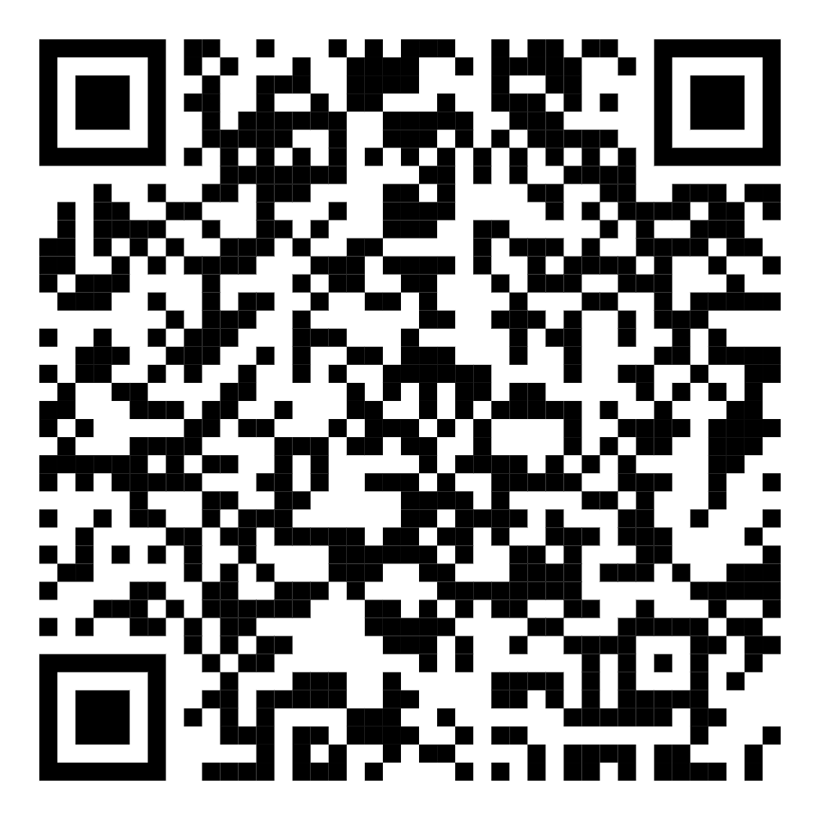
Thank You!
Please be sure to fill out your session survey on the Directions Mobile App!

